Slide 1
CSC3100 Final Review
CUHK-Shenzhen Programming Contest Team
Runyuan He & Xinyan Zhou

Slide 2
Review of core course topics
(1) Hash table: chaining, linear probing, double hashing, definition of alpha, time complexity and its proof.
(2) Heap: insert, delete, building a heap in linear time
(3) Stack: how to do DFS in a stack, DFS tree, compare it and implementing BFS with a queue. (first in last out, first in first out)
(4) Tree: definition; AVL Tree: rotate
(5) Graph: comparison of linked list and linked table (how to use, complexity), Floyd(why it’s DP), shortest path, MST

Slide 3
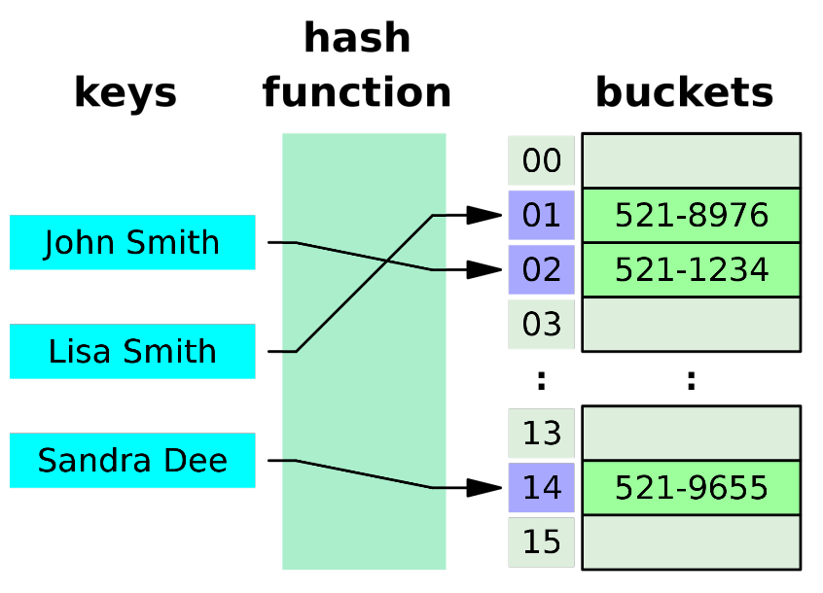
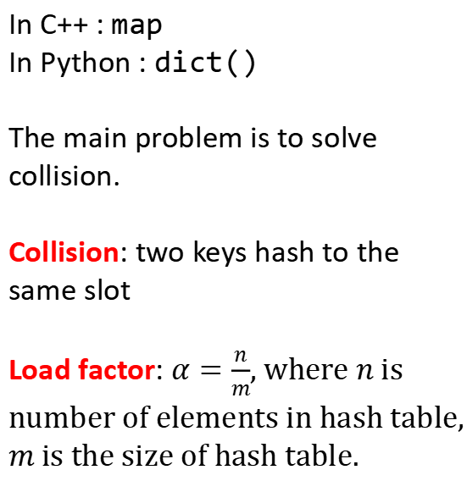
Hash table
In C++ : map
In Python : dict()
The main problem is to solve collision.
Collision: two keys hash to the same slot
Load factor: $α=\frac{n}{m}$, where $n$ is number of elements in hash table, $m$ is the size of hash table.

Slide 4
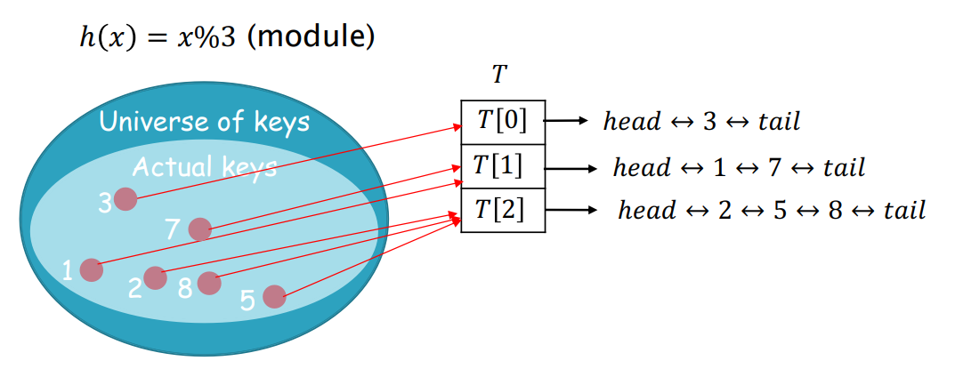
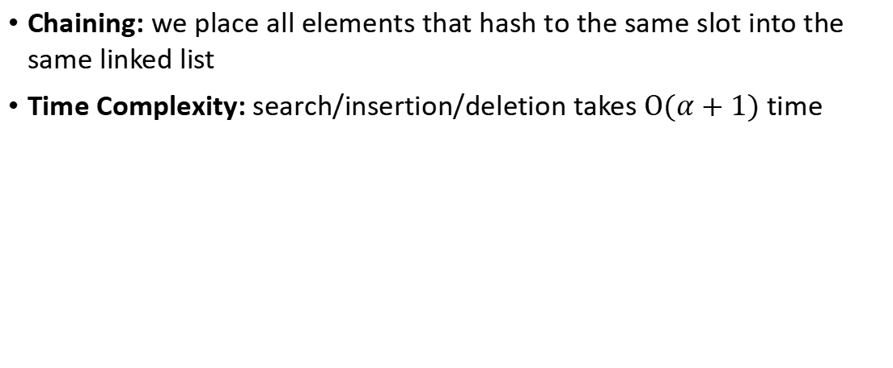
Hash table
Chaining: we place all elements that hash to the same slot into the same linked list
Time Complexity: search/insertion/deletion takes $O(α+1)$ time

Slide 5
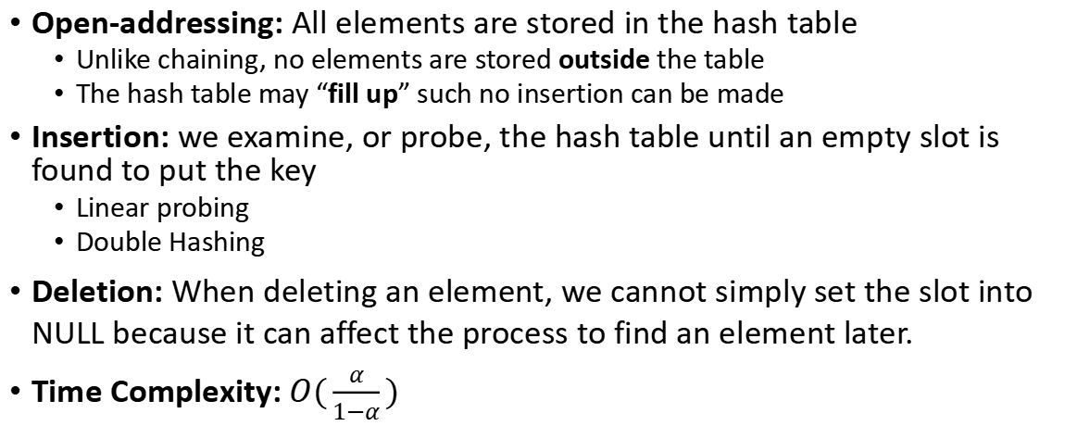
Hash table
Open-addressing: All elements are stored in the hash table
  Unlike chaining, no elements are stored outside the table
  The hash table may “fill up” such no insertion can be made
Insertion: we examine, or probe, the hash table until an empty slot is found to put the key
  Linear probing
  Double Hashing
Deletion: When deleting an element, we cannot simply set the slot into NULL because it can affect the process to find an element later.
Time Complexity: $O(\frac{α}{1−α})$

Slide 6
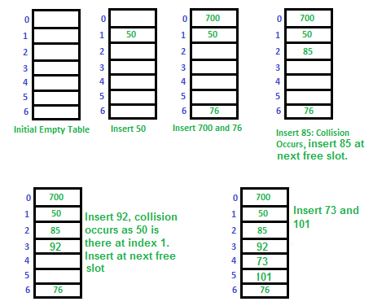
Hash table
Open Addressing (linear probing)
Insert 50, 700, 76, 85, 92, 73, 101

Slide 7
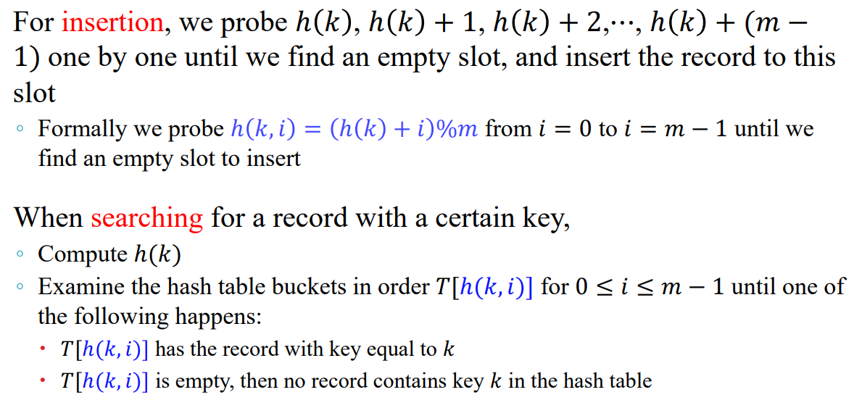
Hash table
In one word:
If the slot is full, then go to the next slot, until an empty slot is found.
Shortcoming: Long sequence of occupied slots, which degrades the query efficiency
Linear Probing

Slide 8
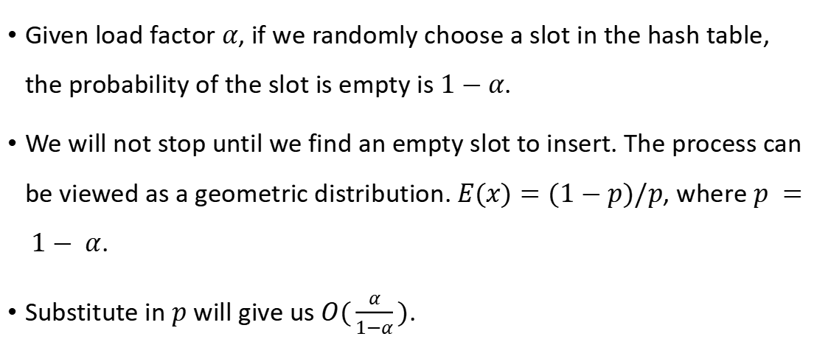
Proof of time complexity
Given load factor $α$, if we randomly choose a slot in the hash table, the probability of the slot is empty is $1−α$.
We will not stop until we find an empty slot to insert. The process can be viewed as a geometric distribution. $E(x)=(1−p)/p$, where $p = 1− α$.
Substitute in $p$ will give us$O(\frac{α}{1−α})$.

Slide 9
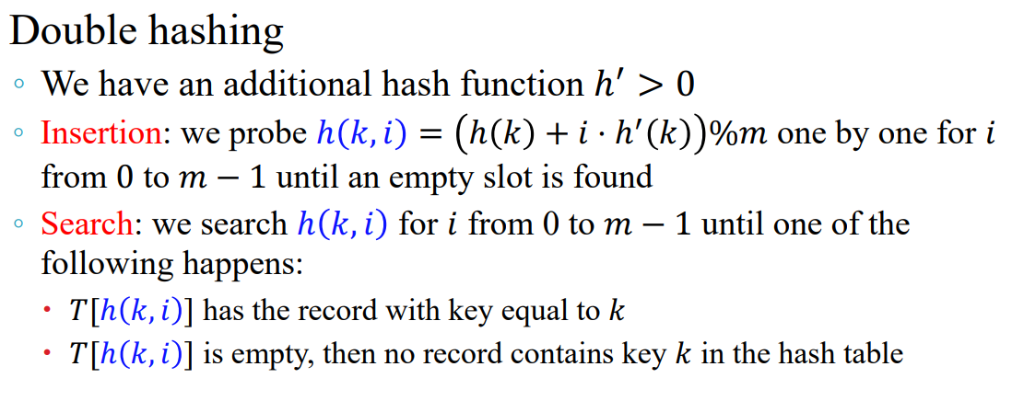
Hash table

Slide 10
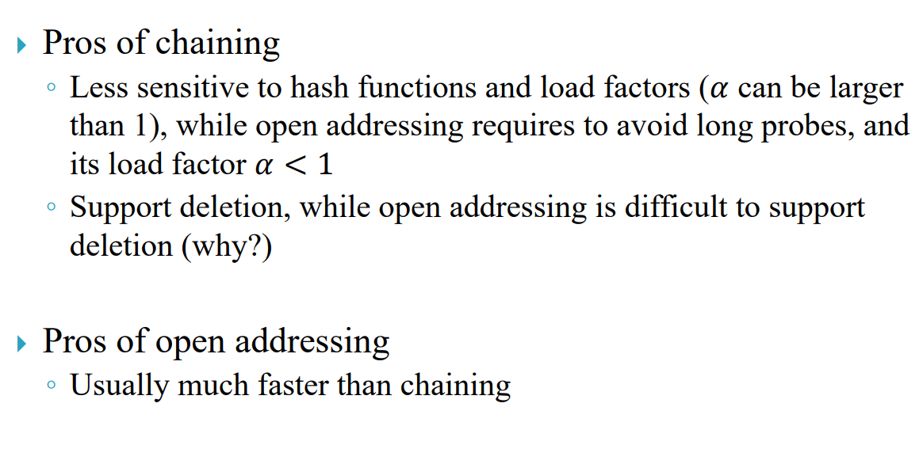
Hash table

Slide 11
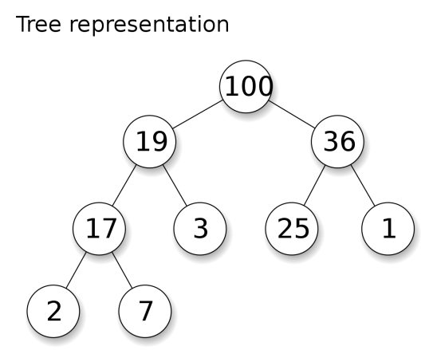
Heap
Heap property
The key stored in each node is either greater than or equal to (≥) or less than or equal to (≤) the keys in the node's children
Shape property
The binary tree is completely filled, except at the bottom level, which is filled from left to right

Slide 12
Pseudo code (build heap)
Heapify(arr, n, i)
largest = i
left = 2 * i + 1
right = 2 * i + 2
if left < n and arr[left] > arr[largest]
largest = left
if right < n and arr[right] > arr[largest]
largest = right
if largest != i
swap(arr[i], arr[largest])
heapify(arr, n, largest)
BuildHeap(arr)
n = arr.size();
for i = n / 2 - 1 downto 0
Heapify(arr, n, i)

Slide 13
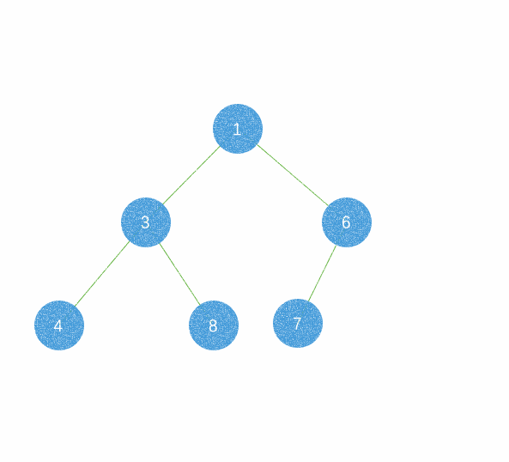
Heap
To insert an element X,
1. Create a hole in the next available location
2. If X can be placed in the hole without violating heap order, insertion is done
3. Otherwise slide the element that is in the hole’s parent node into the hole,
4. Continue this process until X can be placed in the hole (a percolating up
process)

Slide 14
Pseudo code (build heap)
HeapifyUp(arr, index)
parent = (index - 1) / 2;
while index > 0 and arr[index] > arr[parent]
swap(arr[index], arr[parent]);
index = parent;
parent = (index - 1) / 2;
Insert(val)
if heapSize == MAX_SIZE
return
heap[n] = val // insert new element to the end
n++
HeapifyUp(heapSize – 1) // adjust the heap until stable

Slide 15
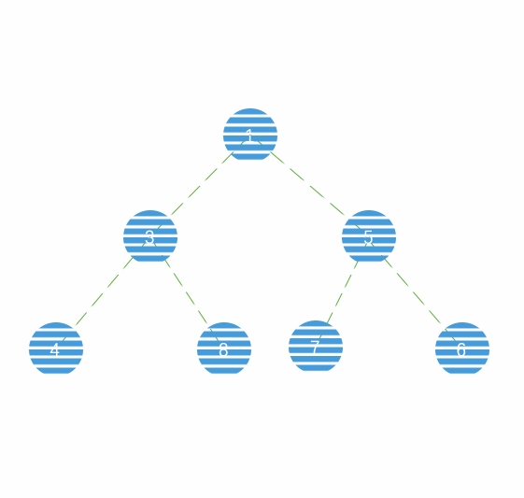
Heap
To Delete an element X,
1. The element at the root (position 1) is to be removed, and a hole is created
2. Fill the root with the last node X
3. Percolate X down (switch X with the smaller child) until the heap order property is satisfied

Slide 16
Pseudo code (build heap)
DeleteHeapTop(arr, n)
if (n <= 0)
return
swap(arr[0], arr[n - 1])
n--
Heapify(arr, n, 0)

Slide 17
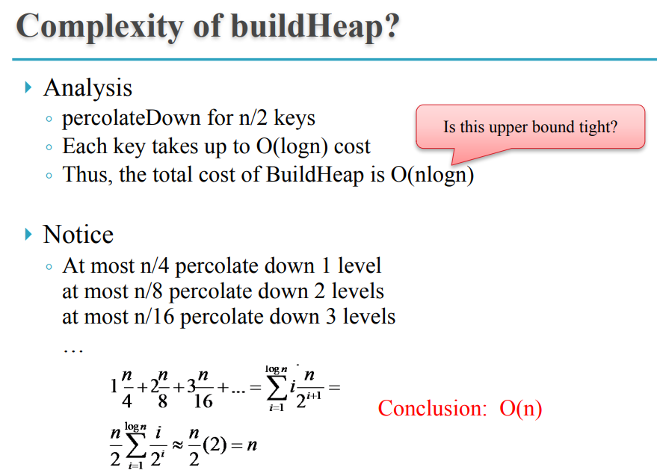
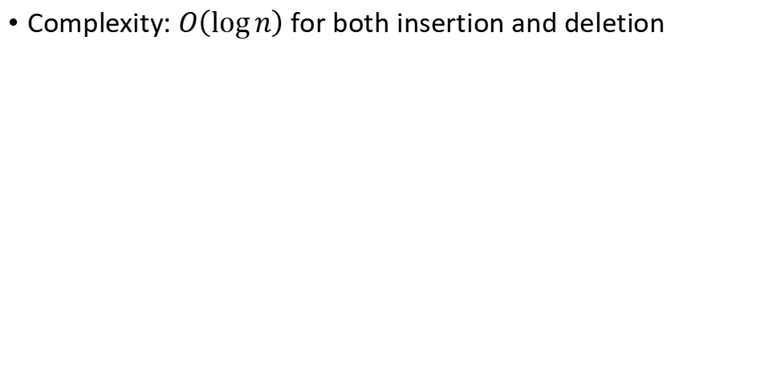
Heap
Complexity: $O\left(\log{n}\right)$ for both insertion and deletion

Slide 18
Stack
void dfs(int start) {
stack.push(start);
vis[start] = true;
while(!stack.empty()) {
int x = stack.top();
stack.pop();
for(v : adjlist[x]) {
if (!vis[v]){
stack.push(v);
vis[v] = true;
}
}
}
}
How to do DFS in a stack?
1. Pop the top element x from the stack.
2. Use x to explore new states
3. Push new states into the stack.

Slide 19
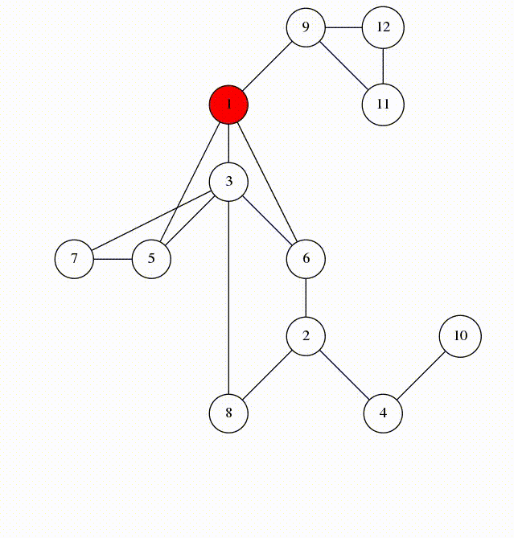
Stack
DFS Tree

Slide 20
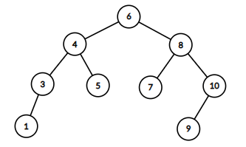
Tree & AVL Tree
Tree : A connected graph with n nodes and n – 1 edges.
AVL Tree : An AVL tree is a self-balancing BST
Balancing: For every node in the tree, the height of the left subtree differs from the height of the right subtree by at most 1

Slide 21
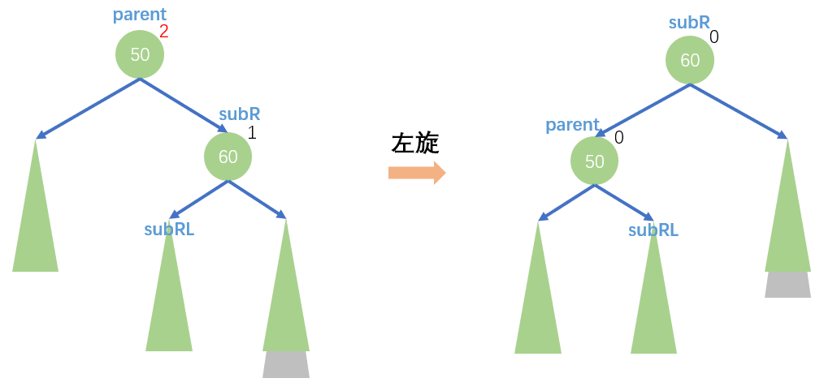
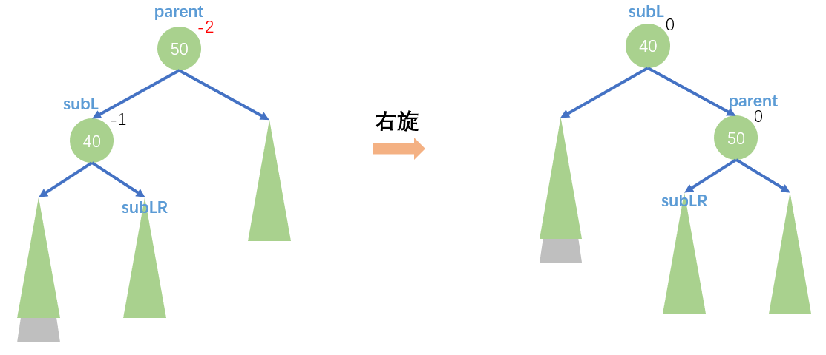
Tree & AVL Tree
Rotate

Slide 22
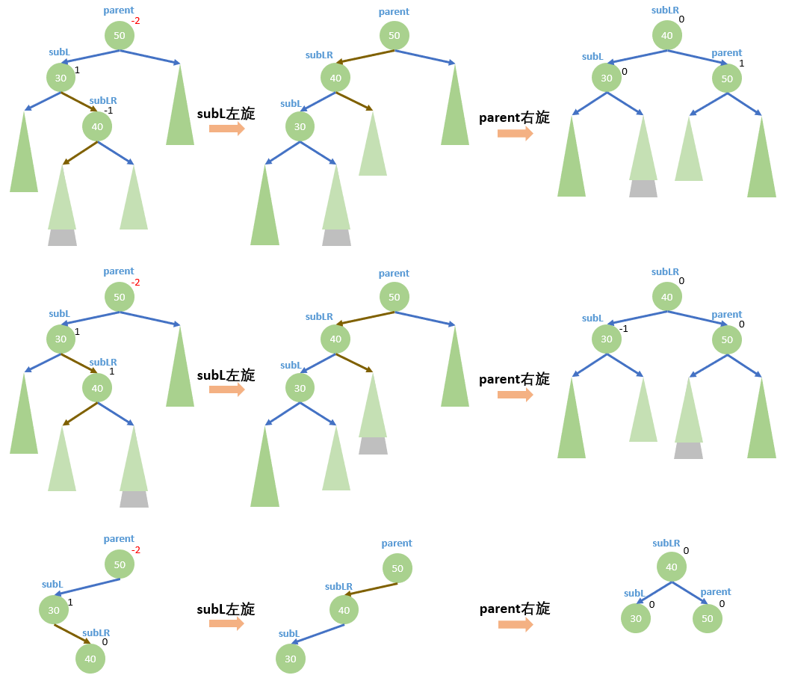
Tree & AVL Tree
Rotate

Slide 23
Pseudo code (Rotation)
Left-Rotate(x):
y = x.right
x.right = y.left
if y.left != NULL:
y.left.parent = x
y.parent = x.parent
if x.parent == NULL:
root = y
else if x == x.parent.left:
x.parent.left = y
else:
x.parent.right = y
y.left = x
x.parent = y
Right-Rotate(x):
y = x.left
x.left = y.right
if y.right != NULL:
y.right.parent = x
y.parent = x.parent
if x.parent == NULL:
root = y
else if x == x.parent.right:
x.parent.right = y
else:
x.parent.left = y
y.right = x
x.parent = y

Slide 24
Pseudo code (double rotation)
Left-Right-Rotate(x):
Left-Rotate(x.left)
Right-Rotate(x)
Right-Left-Rotate(x):
Right-Rotate(x.right)
Left-Rotate(x)

Slide 25
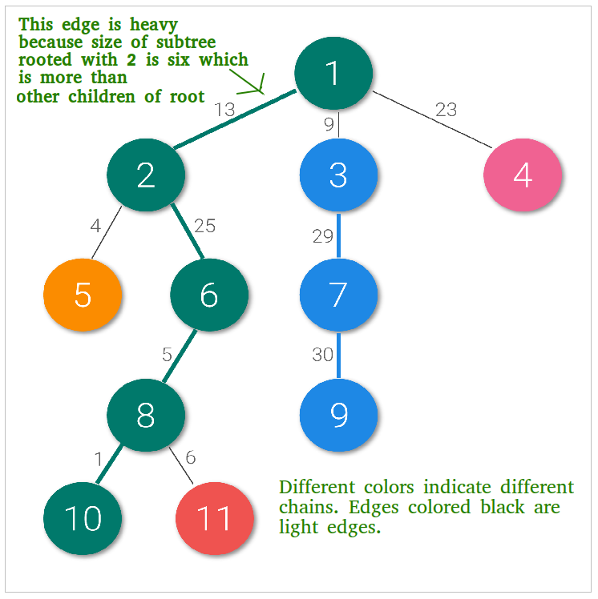
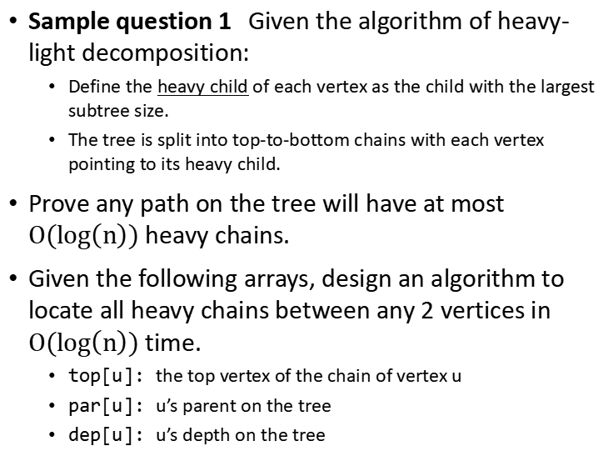
Tree & AVL Tree
Sample question 1 Given the algorithm of heavy-light decomposition:
  Define the heavy child of each vertex as the child with the largest subtree size.
  The tree is split into top-to-bottom chains with each vertex pointing to its heavy child.
Prove any path on the tree will have at most $O(log\left(n\right))$ heavy chains.
Given the following arrays, design an algorithm to locate all heavy chains between any 2 vertices in $O(log\left(n\right))$ time.
  top[u]: the top vertex of the chain of vertex u
  par[u]: u’s parent on the tree
  dep[u]: u’s depth on the tree

Slide 26
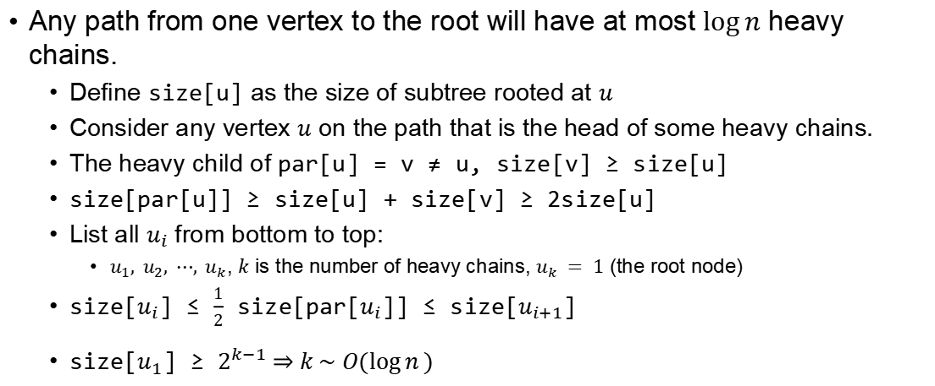
Tree & AVL Tree
Any path from one vertex to the root will have at most $\log{n}$ heavy chains.
  Define size[u] as the size of subtree rooted at $u$
  Consider any vertex $u$ on the path that is the head of some heavy chains.
  The heavy child of par[u] = v ≠ u, size[v] ≥ size[u]
  size[par[u]] ≥ size[u] + size[v] ≥ 2size[u]
  List all $u_{i}$ from bottom to top:
    $u_{1}, u_{2}, ⋯, u_{k}$, $k$ is the number of heavy chains, $u_{k} = 1$ (the root node)
  size[$u_{i}$] ≤ $\frac{1}{2}$ size[par[$u_{i}$]] ≤ size[$u_{i+1}$]
  size[$u_{1}$] ≥ $2^{k−1} \underset{⇒}{} k \sim O(\log{n})$

Slide 27
Tree & AVL Tree
int locate(int u, int v) {
while (top[u] != top[v]) {
if (dep[top[u]] > dep[top[v]])
u = fa[top[u]];
else
v = fa[top[v]];
}
return dep[u] > dep[v] ? v : u;
}

Slide 28
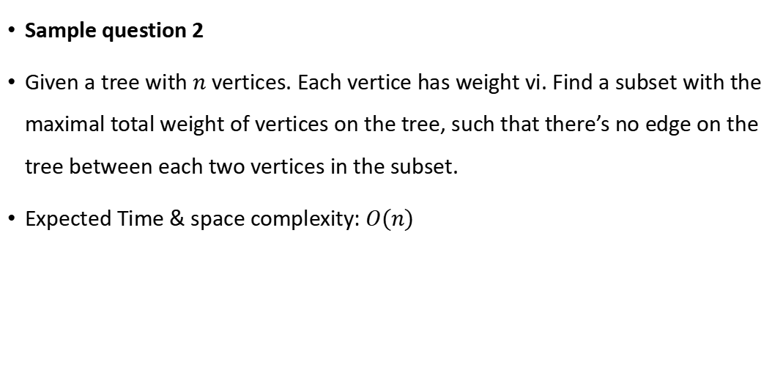
Tree & AVL Tree
Sample question 2
Given a tree with $n$ vertices. Each vertice has weight vi. Find a subset with the maximal total weight of vertices on the tree, such that there’s no edge on the tree between each two vertices in the subset.
Expected Time & space complexity: $O(n)$

Slide 29
int dp[100001][2];
// dp[i][j] denotes choose vertex i if j=1 and not choose vertex i if j=0
void dfs(int x){
for(int v : adj[x]){
dfs(v);
dp[x][1] += dp[v][0];
dp[x][0] += max(dp[v][0], dp[v][1]);
}
dp[x][1] += weight[x];
}
dfs(root) // final answer is max(dp[root][0], dp[root][1]);

Slide 30
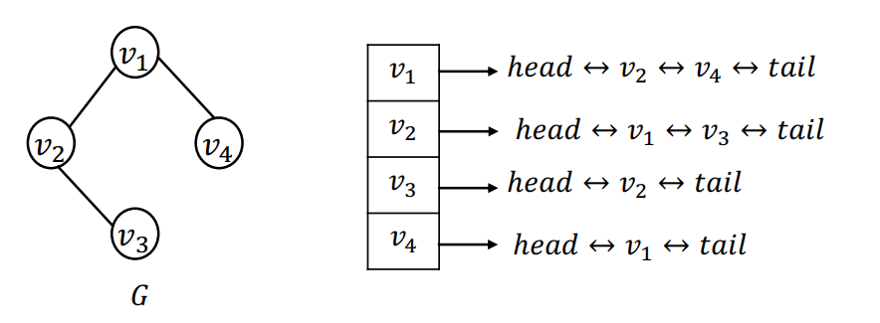
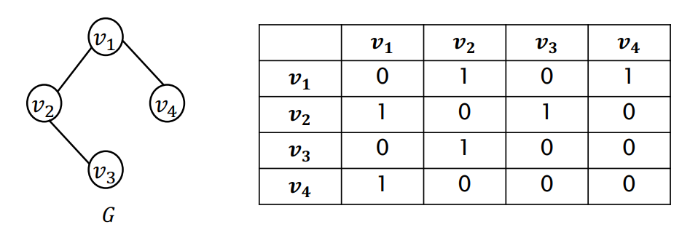
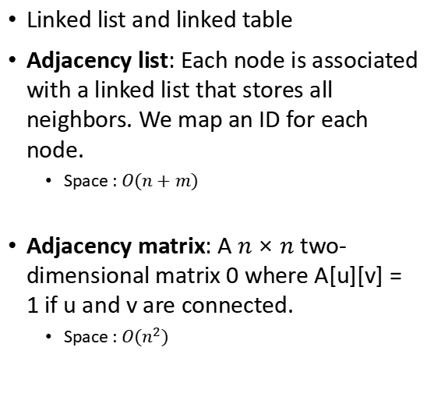
Graph
Linked list and linked table
Adjacency list: Each node is associated with a linked list that stores all neighbors. We map an ID for each node.
  Space : $O(n+m)$
Adjacency matrix: A $n×n$ two-dimensional matrix 0 where A[u][v] = 1 if u and v are connected.
  Space : $O(n^{2})$

Slide 31
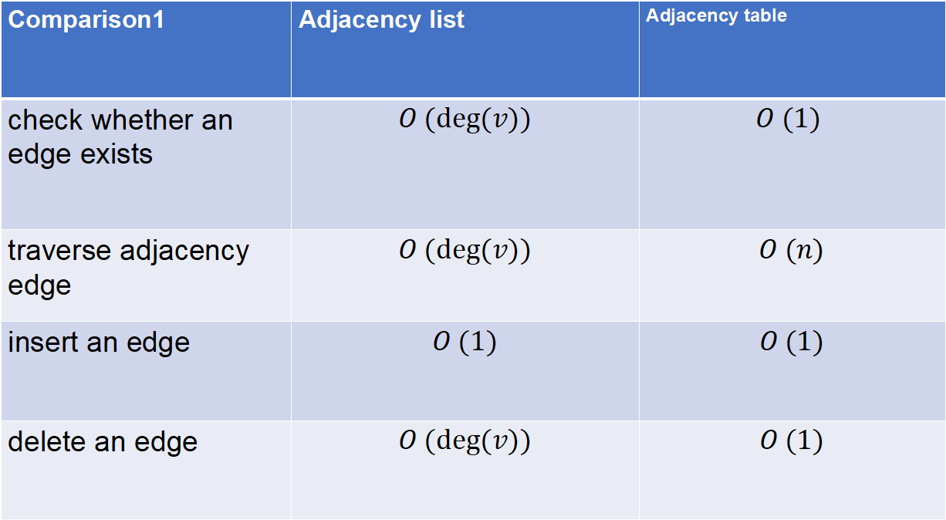
Comparison1 | Adjacency list | Adjacency table
check whether an edge exists | $$O (deg⁡(v))$$ | $$O (1)$$
traverse adjacency edge | $$O (deg⁡(v))$$ | $$O (n)$$
insert an edge | $$O (1)$$ | $$O (1)$$
delete an edge | $$O (deg⁡(v))$$ | $$O (1)$$

Slide 32
Shortest Path on Graph
Dijkstra (based on greedy)
Single-source, non-negative edge weights
Iteratively selecting the node with the smallest known distance
Updating the shortest path estimates for its neighbors
Repeating this process until all nodes have been visited
The algorithm ensures that once a node's shortest path is determined, it will not change. (Edge weights must be non-negative)

Slide 33
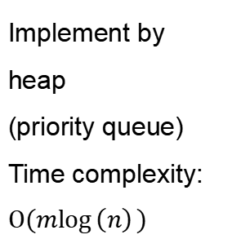
Implement by heap
(priority queue)
Time complexity: $O(m\log\left(n\right))$
void dijkstra(int source){
for(int i = 1;i <= n;i++) dist[i] = inf;
dist[source] = 0;
priority_queue<pair<int,int>,vector<pair<int,int>>,greater<pair<int,int>>> pq;
pq.push({0,source});
while(!pq.empty()){
int temp = pq.top().second;
pq.pop();
if(vis[temp]) continue;
vis[temp] = true;
for(int v:adj[temp]) if(dist[v] > dist[temp] + edgeweight[temp][v]){
dist[v] = dist[temp] + edgeweight[temp][v];
pq.push({dist[v], v});
}
}
}

Slide 34
2. Floyd (based on dynamic programming)
All sources, arbitrary edge weights
Considering each node as an intermediate point.
Starting with direct distances between nodes
Iteratively updates the distance matrix by checking if a path through an intermediate node offers a shorter path.
This process continues until all possible pairs have been considered.

Slide 35
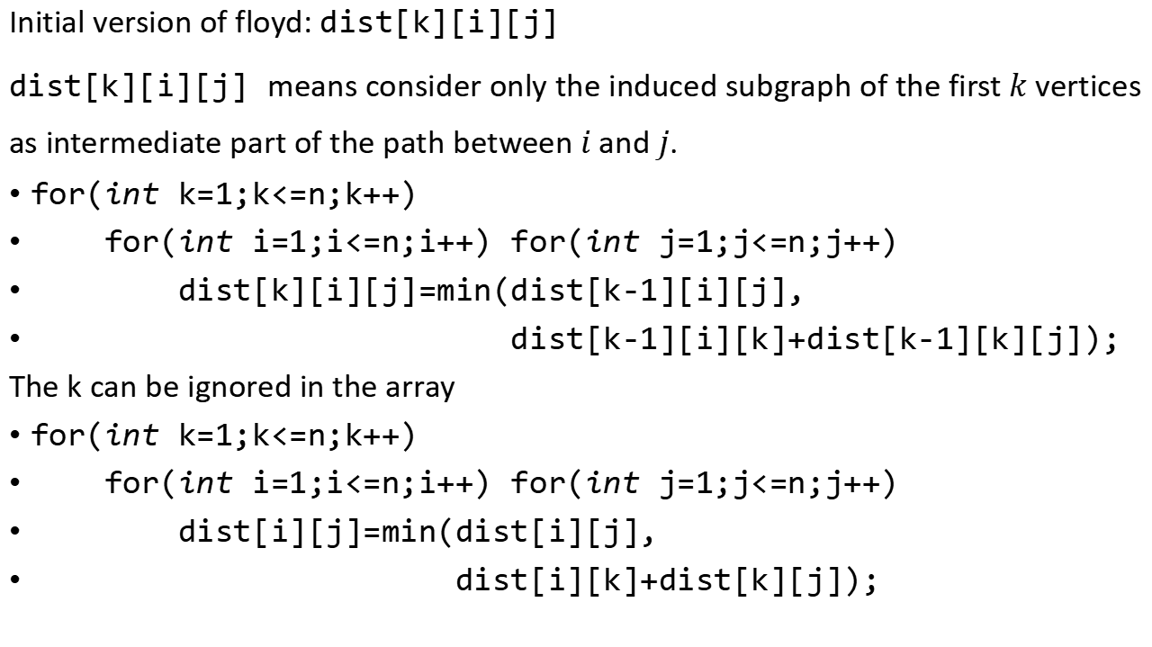
Initial version of floyd: dist[k][i][j]
dist[k][i][j] means consider only the induced subgraph of the first $k$ vertices as intermediate part of the path between $i$ and $j$.
for(int k=1;k<=n;k++)
for(int i=1;i<=n;i++) for(int j=1;j<=n;j++)
dist[k][i][j]=min(dist[k-1][i][j],
dist[k-1][i][k]+dist[k-1][k][j]);
The k can be ignored in the array
for(int k=1;k<=n;k++)
for(int i=1;i<=n;i++) for(int j=1;j<=n;j++)
dist[i][j]=min(dist[i][j],
dist[i][k]+dist[k][j]);

Slide 36
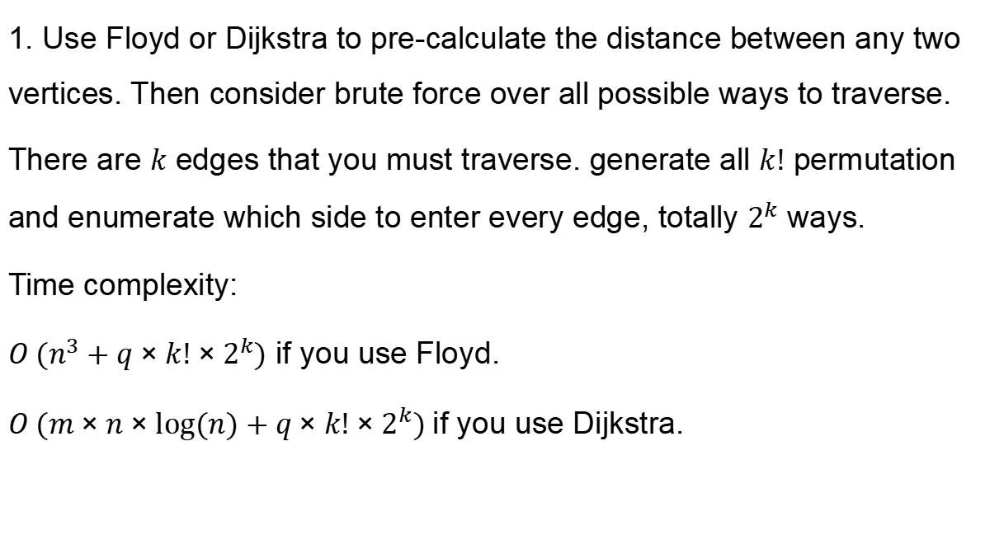
Homework 4 problem 1 solution
1. Use Floyd or Dijkstra to pre-calculate the distance between any two vertices. Then consider brute force over all possible ways to traverse.
There are $k$ edges that you must traverse. generate all $k!$ permutation and enumerate which side to enter every edge, totally $2^{k}$ ways.
Time complexity:
$O (n^{3}+q×k!×2^{k})$ if you use Floyd.
$O (m×n×log⁡(n)+q×k!×2^{k})$if you use Dijkstra.

Slide 37
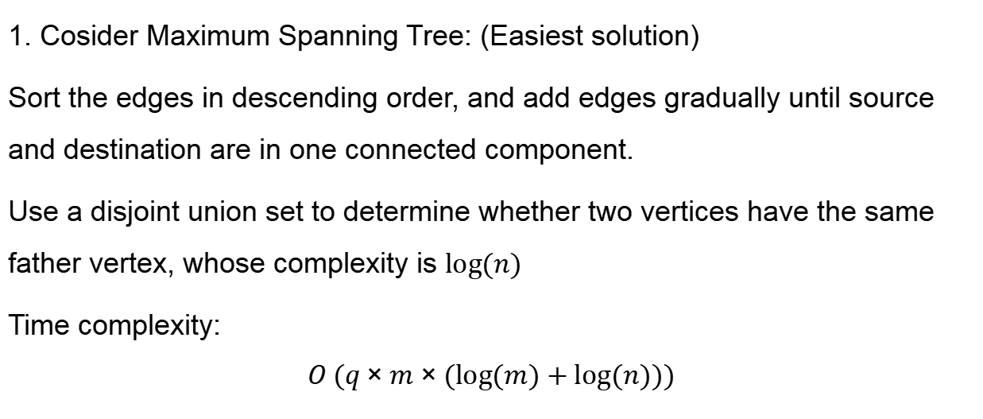
Homework 4 problem 2 solution
1. Cosider Maximum Spanning Tree: (Easiest solution)
Sort the edges in descending order, and add edges gradually until source and destination are in one connected component.
Use a disjoint union set to determine whether two vertices have the same father vertex, whose complexity is $log⁡(n)$
Time complexity:
$$O (q×m×(log⁡(m)+log⁡(n)))$$

Slide 38
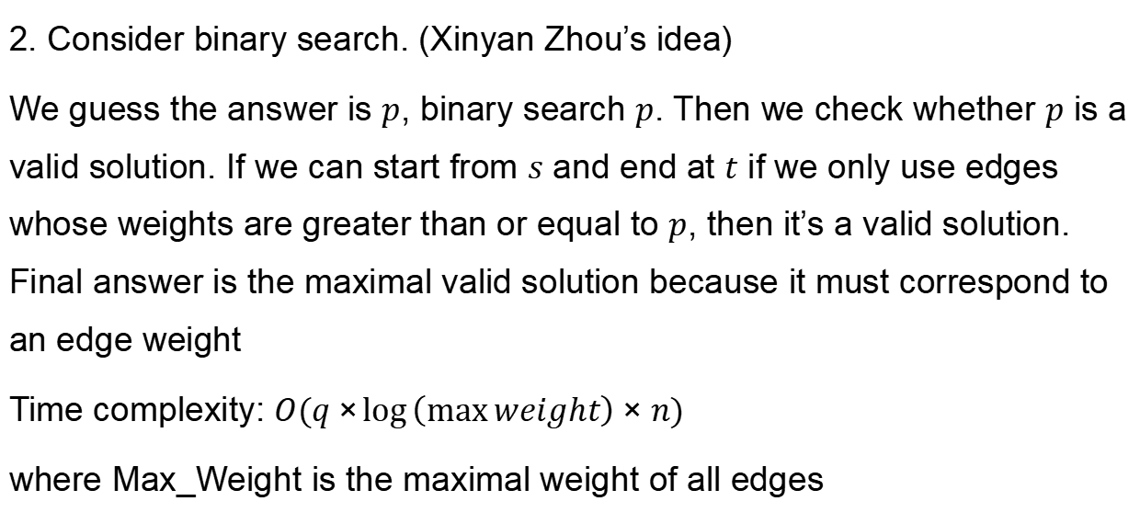
Homework 4 problem 2 solution
2. Consider binary search. (Xinyan Zhou’s idea)
We guess the answer is $p$, binary search $p$. Then we check whether $p$ is a valid solution. If we can start from $s$ and end at $t$ if we only use edges whose weights are greater than or equal to $p$, then it’s a valid solution. Final answer is the maximal valid solution because it must correspond to an edge weight
Time complexity: $O(q×\log\left(\max{weight}\right)×n)$
where Max_Weight is the maximal weight of all edges

Slide 39
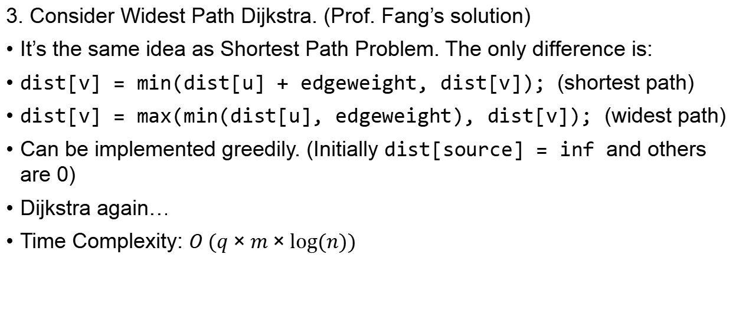
Homework 4 problem 2 solution
3. Consider Widest Path Dijkstra. (Prof. Fang’s solution)
It’s the same idea as Shortest Path Problem. The only difference is:
dist[v] = min(dist[u] + edgeweight, dist[v]); (shortest path)
dist[v] = max(min(dist[u], edgeweight), dist[v]); (widest path)
Can be implemented greedily. (Initially dist[source] = inf and others are 0)
Dijkstra again…
Time Complexity: $O (q×m×log⁡(n))$

Slide 40
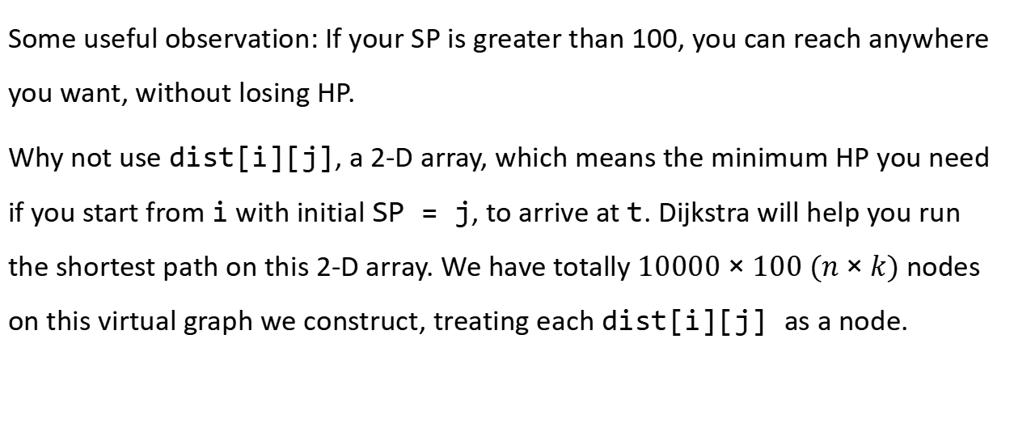
Homework 4 problem 3 solution
Some useful observation: If your SP is greater than 100, you can reach anywhere you want, without losing HP.
Why not use dist[i][j], a 2-D array, which means the minimum HP you need if you start from i with initial SP = j, to arrive at t. Dijkstra will help you run the shortest path on this 2-D array. We have totally $10000×100 (n×k)$ nodes on this virtual graph we construct, treating each dist[i][j] as a node.

Slide 41
Homework 4 problem 3 solution
  dist[t][0]=0;
  priority_queue<pair<int,pair<int,int>>,vector<pair<int,pair<int,int>>>,greater<pair<int,pair<int,int>>>> q;
  q.push({0,{t,0}});
  while(q.size()){
  int x=q.top().second.first;
  int r=q.top().second.second;
  q.pop();
  if(vis[x][r]||r==100) continue;
  vis[x][r]=1;
  for(int i=head[x];i;i=e[i].next){
  int to=e[i].to;
  int w=e[i].wei;
  if(dist[to][r+1]>dist[x][r]+w/(r+1)){
  dist[to][r+1]=dist[x][r]+w/(r+1);
  q.push({dist[to][r+1],{to,r+1}});
  }
  }
  }

Slide 42
Homework 4 problem 3 solution
int ans = inf;
for(int i = 0; i <= 100; i++){
ans = min(ans, dist[s][i]);
}
for(int i = 1; i <= n; i++){
ans = min(ans, dist[i][100]);
}
cout << ans << '\n';

Slide 43
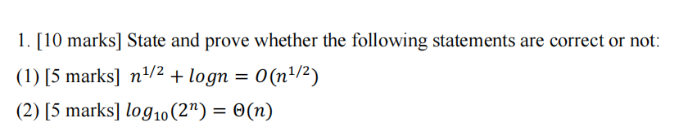
Sample Final Review

Slide 44
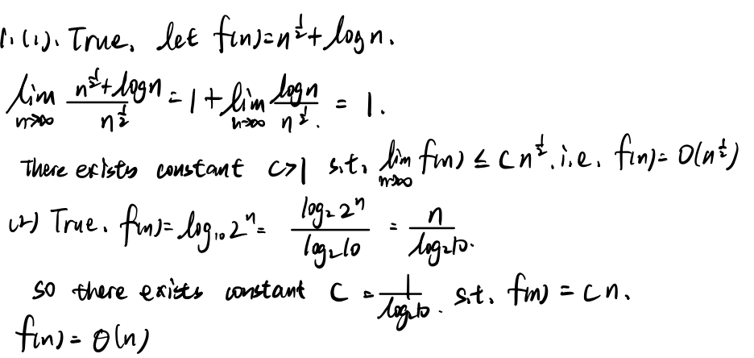

Slide 45
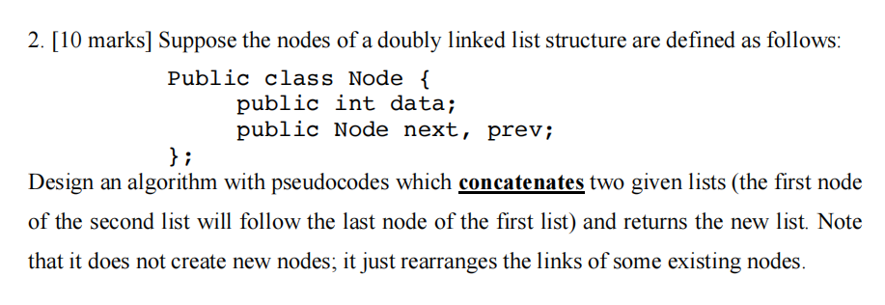
Sample Final Review

Slide 46
Node union(Node first, Node second){
  Node ans = first;
  while(first.next != NULL){
  first = first.next;
  }
  first.next = second;
  second.prev = first;
  return ans;
  // we need to return the head of the merged linked list
  // otherwise we will lose the entire linked list.
}

Slide 47
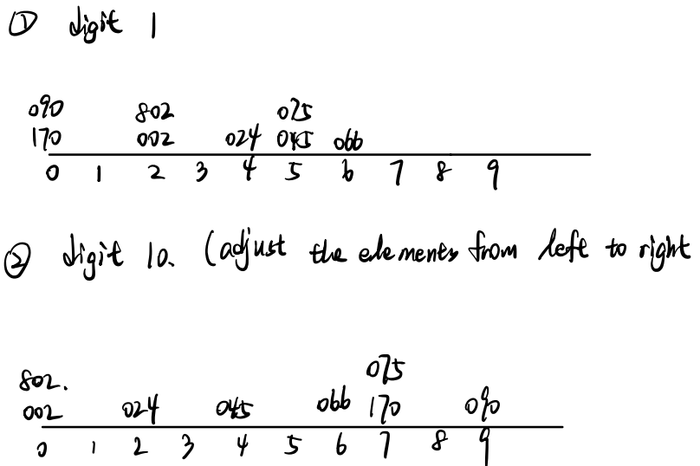

Slide 48
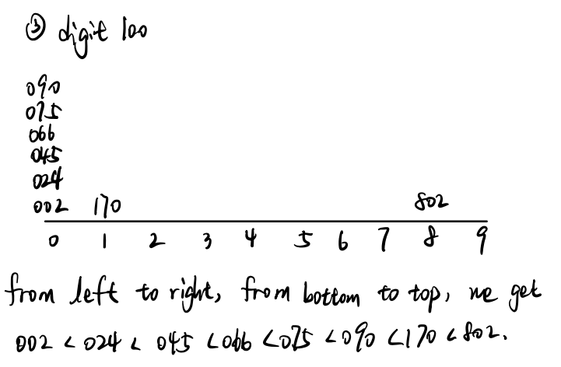

Slide 49
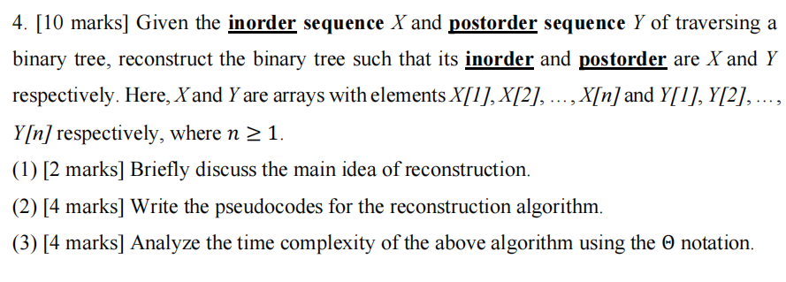
Sample Final Review

Slide 50
vector<int> inorder, postorder;
int pos[200001];
Node root = Node(postorder[n-1]);
Node* dfs(int left, int right, int posindex) {
if (left > right) return nullptr;
int rootValue = postorder[posindex];
Node* root = new Node(rootValue);
int rootPos = pos[rootValue];
root->right = dfs(rootPos + 1, right, posindex - 1);
root->left = dfs(left, rootPos - 1, posindex - (right - rootPos) - 1);
return root;
}
for(int i = 0; i < n; i++){
pos[inorder[i]] = i;
}
Node* root = dfs(0, n-1, n-1);

Slide 51
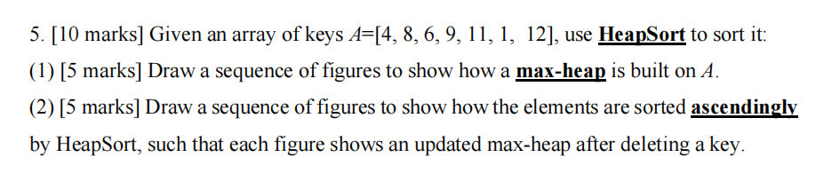
Sample Final Review

Slide 52
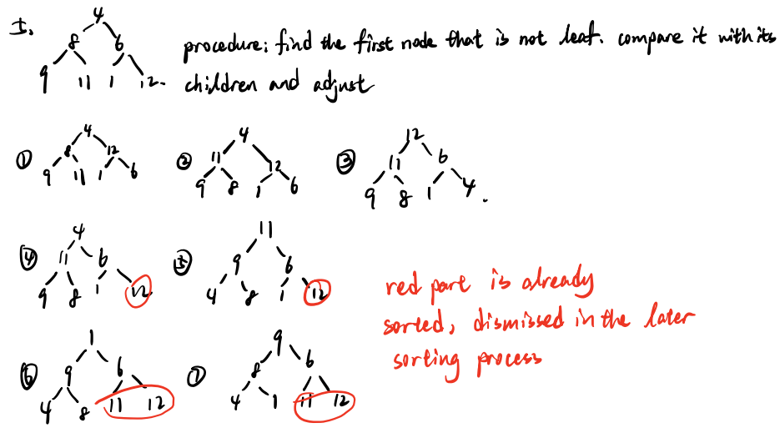

Slide 53
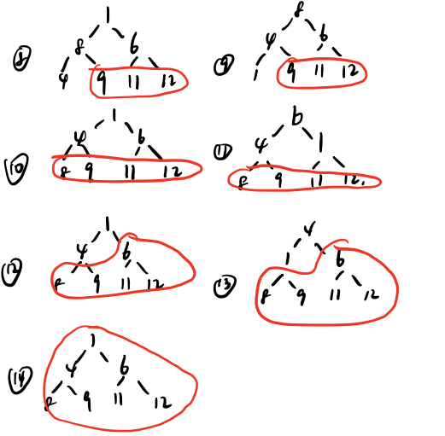

Slide 54
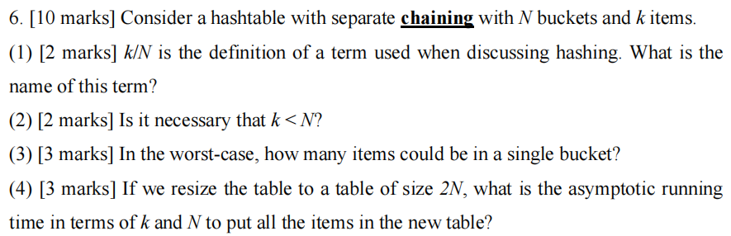
Sample Final Review

Slide 55
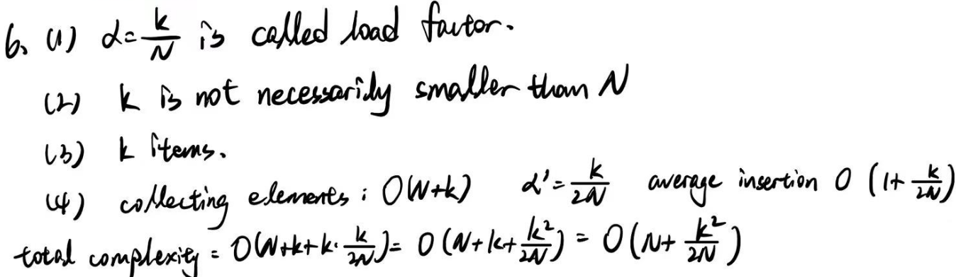

Slide 56
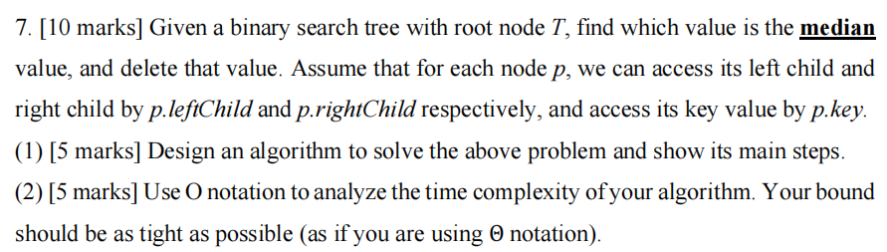
Sample Final Review

Slide 57
vector<int> vec;
void dfs(Node t){
dfs(t.leftChild);
vec.push_back(t.key);
dfs(t.rightChild);
}
dfs(T);
int median = vec[(vec.size() - 1) / 2];
Node temp = T;
while(temp.key != median){
if(temp.key < median){
temp = temp.rightChild;
  }else{
  temp = temp.leftChild;
  }
}
// delete Node temp and replace it with its successor, ommitted here.

Slide 58
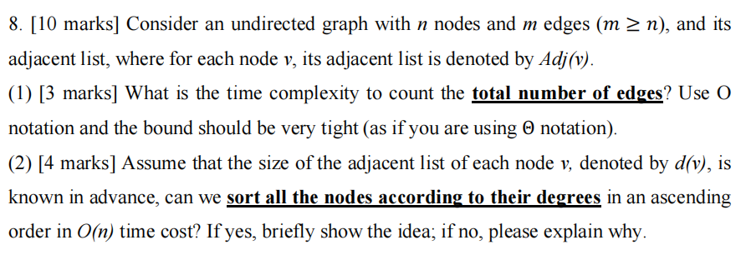
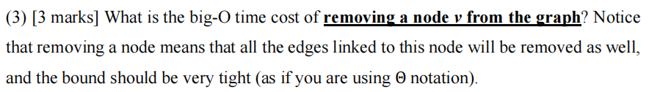
Sample Final Review

Slide 59
Answer:
(1) O (n+m) and O (m) are fine
(2) Yes, we can use counting sort or radix sort.
(3) O (n+m) or O(m)

Slide 60
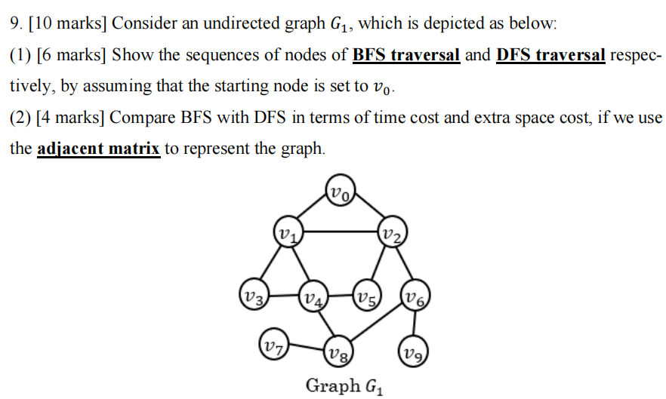
Sample Final Review

Slide 61

Answer:
BFS: v0, v1, v2, v3, v4, v5, v6, v8 v9, v7
DFS: v0, v1, v3, v4, v8, v7, v6, v9, v2, v5
BFS: Time: O($V^{2}$) Space: O(V) (implemented by a queue)
DFS: Time: O($V^{2}$) Space: O(V) (use working stack)

Slide 62

Sample Final Review

Slide 63
(1) Break the edge, use label[i] array to denote which connected component vertex i is in. For the broken edge, DFS or BFS it’s two vertices, to construct the label array. O(V) here. Then sort the edges in ascending order w.r.t weight. O(ElogE) here. Scan the edges and find the minimum weight of an edge which connects two vertices with different labels. O(E) here.
Time Complexity: O(V+ElogE)

Slide 64

(2) Note that there are only V-1 edges in MST
Try to replace every edge in MST with the weight-decreased edge. O(V) here for enumerating. Check whether the graph is connected using DFS/BFS. That is, only start from any single vertex in this graph and run DFS/BFS, check whether every vertex in this graph is visited O(V) for check. If so, then it’s a valid replacement. Update the answer.
Time Complexity: O$(V^{2}$) (Enumerate * Check)

